Slide 1
BIPOLAR AND DEPRESSIVE DISORDERS

Slide 2
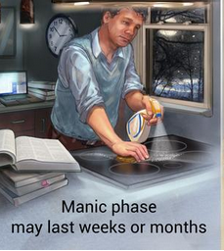
Definition;
Bipolar disorder is a brain disorder that brings forth unusual shifts in mood, activity levels, and also the ability to carry out daily tasks.
It is also known as the manic-depressive illness. Bipolar disorder is classified into four basic types where all of them involve changes that are clear in the mood, energy, and activity levels.

Slide 3
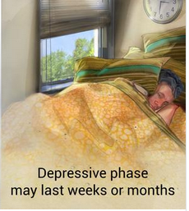
Specific type
Cyclothymic Disorder also is known as Cyclothymia is described by numerous periods of hypomanic symptoms as well as numerous periods of depressive symptoms that last for up to two years.
It is a milder form of bipolar disorder that is characterized by episodes of hypomanic symptoms

Slide 4
Specific type cont’
. These symptoms are not sufficient in number, duration, and severity to meet the full criteria of a depressive episode.
Approximations of 0.4% to 1% end up experiencing cyclothymia in their lifetime.
The disorder starts in adolescence or early adulthood with a 15% to 50% risk of the affected person to develop either bipolar I disorder or bipolar II disorder.

Slide 5
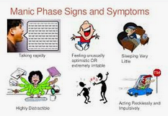
symptoms
Its symptoms that are cataloged by DSM-V include:
Irritability
Excessive or overly good, euphoric mood
Inability to concentrate
Unrealistic beliefs in one's powers and abilities
Needing less sleep among others

Slide 6
Causes and treatments
Although the mood swings are irregular and abrupt, the severity of the mood swings is not extreme like in people with bipolar disorder.
However, its cause still remains unknown. Treatment for cyclothymia resembles the one used for bipolar I disorder and Bipolar II disorder.

Slide 7
Causes and treatments cont’
The level is however dependent on the severity of the symptoms. Most cases of bipolar disorder can achieve substantial stabilization of the symptoms when proper medication is used.
And since it’s a recurrent, long-term preventive treatments are highly recommended. Additionally, a strategy that combines psychotherapy and medication is optimal for managing the disorder over time.

Slide 8
Depressive Disorders and type
On the other hand, depressive disorders are characterized by the persistent feelings of worthlessness and sadness and the lack of desire to engage informally pleasurable activities. It is a complex mind and body illness that interferes with everyday functioning. There are different types of depression. Some are caused by different events in one's life while others are caused by chemical changes in the brain.
Major depression is what is commonly referred to as a major depressive disorder

Slide 9
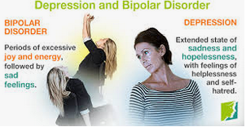
Symptoms
Some of the symptoms include:
Weight loss or gain
Reduced interest in pleasurable activities
Feeling worthless or guilty
Being tired and without energy
Suicidal thoughts among others

Slide 10
Causes and treatments
There is no single cause for depression, but evidence indicates it results from a combination of genetic, biologic, environmental, and even psychological factors.
Like it is the case with other illnesses, the sooner the treatment begins, the more effective it is and the bigger the chances of preventing its recurrence.
The best treatment for depression starts with an examination by a physician. This gives room for ruling out the possibilities of depression symptoms that are actually used by viral infections and thyroid disorders.

Slide 11
Causes and treatments cont’
If a physical cause is ruled out, a psychological evaluation that includes mental status exam should be done.
Antidepressants are used to normalize the brain chemicals that occur naturally. Patients should take regular doses for at least three to four weeks before experiencing a therapeutic effect. However, they should continue taking the medication even in instances where they start feeling better so as to prevent chances of relapse of the depression.

Slide 12
References
Psychology today, (n. d). Depressive Disorders retrieved from https://www.psychologytoday.com/us/conditions/depressive-disorders
Psychology today, (n. d). Cyclothymic Disorder Retrieved from https://www.psychologytoday.com/us/conditions/cyclothymic-disorder
National Institute of Mental Health, (n. d). Bipolar Disorder retrieved from https://www.nimh.nih.gov/health/topics/bipolar-disorder/index.shtml

